Slide 1
Capstone project- The battle of neighbourhoods- presentation
Siri devarapalli

Slide 2
Introduction
Background: To minimize the chance of feeling any discomfort after shifting we should research the neighbourhood thoroughly. We should consider our priorities and make an informed choice so that we don’t regret it after getting there. One common concern is safety.
Problem: This project aims to select the safest community in Chicago based on total crimes, explore the community to find the ten most common venues in each neighbourhood and finally cluster the neighbourhoods using k-means clustering.
Interest: People who are considering to relocate to Chicago will find it easy to identify the safest community in Chicago and common venues in each neighbourhood.

Slide 3
Data acquisition and cleaning
The data acquired for this project is from three sources.
The first data source uses a Chicago crime that shows all the crimes from 2001 till 2020 in Chicago.
The second source is scraped from a Wikipedia page that contains the list of community areas.
The third data source is a list of all the neighbourhoods in each community area as found on a Wikipedia page.

Slide 4
Data cleaning
The data preparation for each of the three sources was done separately.
From the crime in Chicago dataset the crimes of year 2017 are only selected.
We make sure that the community area numbers are same so that we can merge the data frames using these numbers(1-77). To identify the community area with the least crimes in the year 2017.
After visualising the crime in each community area we can find the community with the least crime rate and hence tag the safest community area.
The third source of data is created from the list of neighbourhoods from scratch using the list available on Wikipedia.
This data contains all the neighbourhoods in the safest community areas.
The coordinates are generated using Google maps API geo-encoding .
The new dataset is used to generate the venues for each neighbourhood using the Foursquare API. These neighbourhoods are grouped using K means clustering.

Slide 5
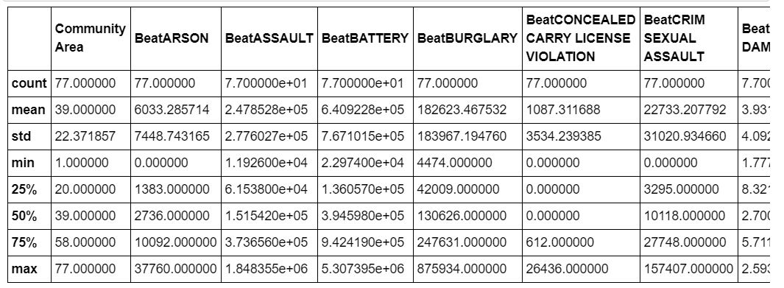
methodology
Exploratory data analysis
Statistical summary of crimes
There are a total of 137 crimes of which we will select the major crimes. Theft is the most common crime recorded in 2017. theft is followed by other offense, weapons violation, stalking and sex offense.

Slide 6
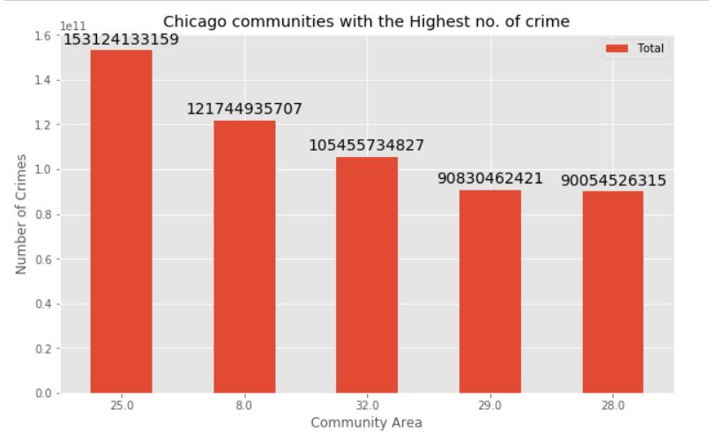
Community areas with the highest crime rate
Comparing 5 communities with the highest crime rate it is evident that the community areas 25, 8, 32, 29 and 28 have the highest crime rate compared to other communities.

Slide 7
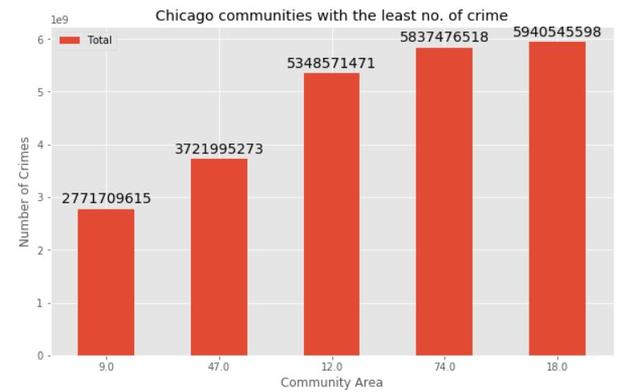
Community areas with the lowest crime rate
Comparing the communities with the lowest crime rate in 2017 we find that the community areas 9, 47, 12, 74 and 18 have the lowest crime rates. Community 9 is Edison park. It has the lowest crime rate but it is very small and is on the outskirts of Chicago. It’s population is also very low. So, we will not consider this community area. We will consider the next community areas which are 47 and 12.

Slide 8
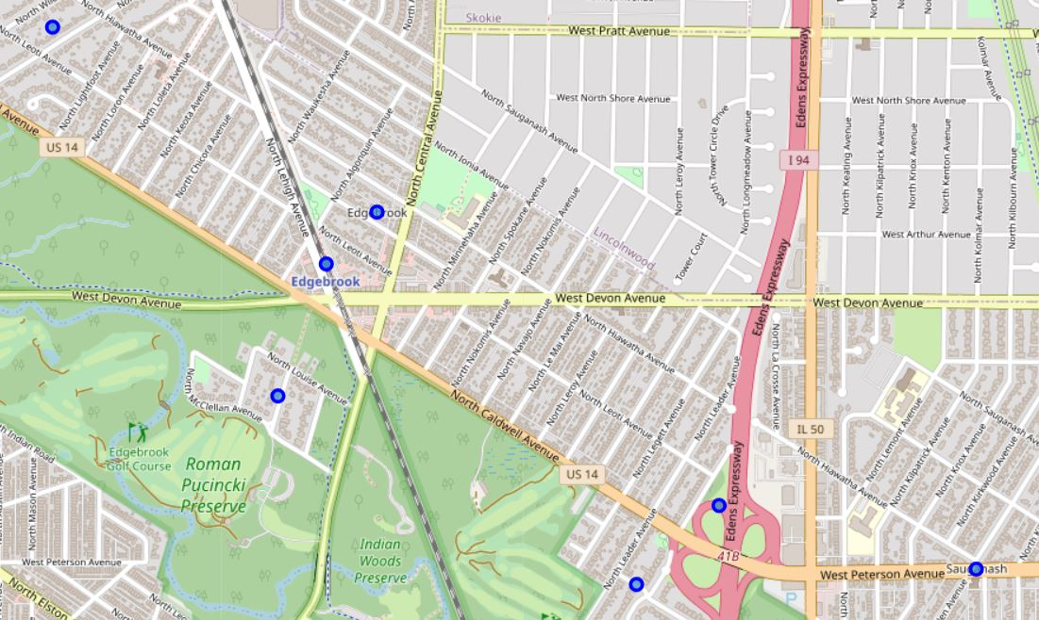
Neighbourhoods in community areas Burnside and Forest Glen
There are 8 neighbourhoods in the community areas of Burnside and Forest Glen. They are visualized on a map using folium on python.

Slide 9
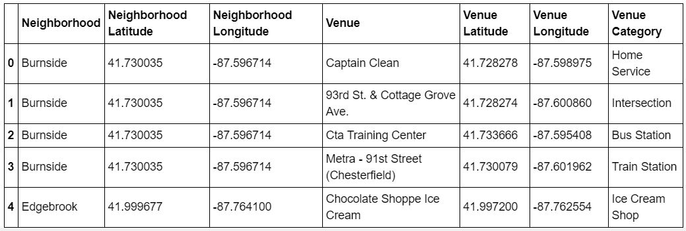
modelling
Using the final dataset we find venues near each neighbourhood in Forest Glen and Burnside in a radius of 500 meters by connecting to the Foursquare API.

Slide 10
One hot encoding is done on the venues(One hot encoding is a process by which categorical variables are converted into a form that can be provided to ML algorithms to do a better job in prediction). The venues data is then grouped by the neighbourhood and mean of the venues are calculated, finally the top ten venues are selected.
To help people find similar neighbourhoods we use k mean clustering (a form of unsupervised machine learning that clusters data based on predefined cluster size). We will use a cluster size of 3 which will divide 8 neighbourhood into 3 clusters. The reason to cluster the neighbourhoods is to make it easier for people to eliminate irrelevant neighbourhoods based on amenities and venues in each neighbourhood.

Slide 11
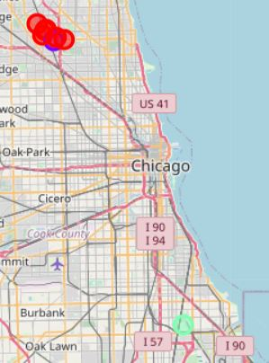
results
After running the k means clustering algorithm we can access each cluster to see which neighbourhoods were assigned to each of the three clusters. Visualizing the clusters by using a map from folium library.
Each cluster is colour coded for readability. Red represents the first cluster. Blue represents the second cluster. Green represents the third cluster.

Slide 12
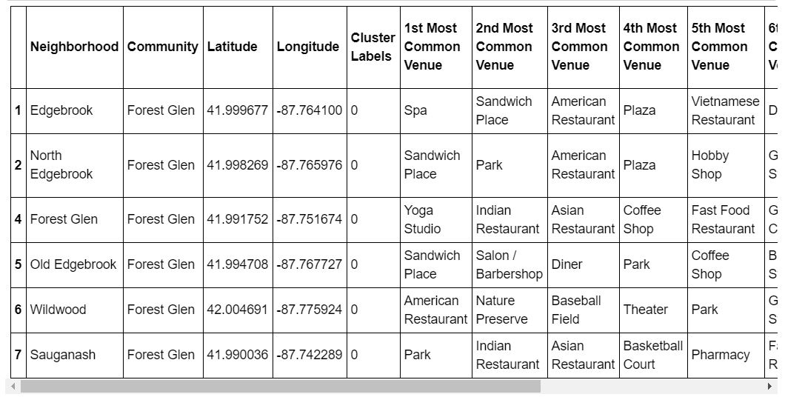
Cluster 1
Cluster one is the biggest cluster. It has 6 neighbourhoods. Upon observation we can find out that it’s most common venues are restaurants, parks, shops and fitness studios.

Slide 13
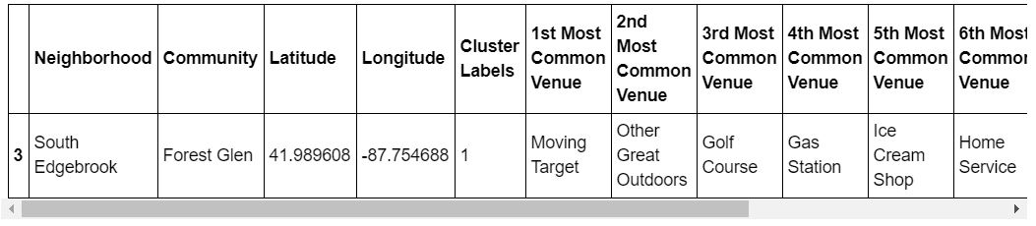
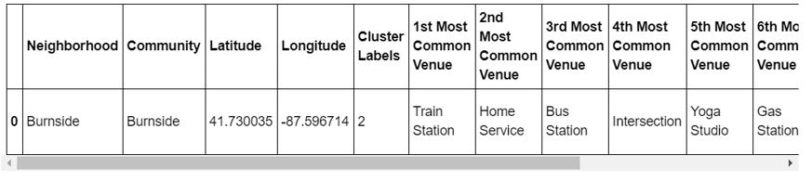
Cluster 2
The second cluster consists of one neighbourhood. The venues are a target store, the great outdoors, a gold course, gas station and a home service.
Cluster 3
The third cluster has one neighbourhood. The venues are a train station, home service, bus station, Intersection, fitness centre and a gas station.

Slide 14
discussion
The aim of this project is to help people who want to relocate to the safest community in London, expats can chose the neighbourhoods to which they want to relocate based on the most common venues in it.
If a person is looking for a neighbourhood with good connectivity and public transportation we can see that Clusters 3 has Train stations and Bus stops as the most common venues.
If a person is looking for a neighbourhood with stores and restaurants in a close proximity then the neighbourhoods in the first cluster is suitable.
For a family I feel that the neighbourhoods in Cluster 2 is more suitable dues to the common venues in that cluster, these neighbourhoods have common venues such as golf course, Gym/Fitness centre, Restaurants, Home service and great outdoors which is ideal for a family.
The preference of venues in their neighbourhood may vary from person to person, in this way they can select a neighbourhood according to their preference.

Slide 15
conclusion
This project helps a person get a better understanding of the neighbourhoods with respect to the most common venues in that neighbourhood. It is always helpful to make use of technology to stay one step ahead i.e. finding out more about places before moving into a neighbourhood.
We have just taken safety as a primary concern to shortlist the community area in Chicago. The future of this project includes taking other factors such as cost of living in the areas into consideration to shortlist the borough based on safety and a predefined budget.

